Slide 1
Sales Interpretation using logistic regression
Group Members:
Name: Joy Paul
ID: 2020-1-60-176
Name: Shocho Ghosh
ID: 2020-1-60-120
Name: Shams E siam
ID: 2020-1-60-265
Name: N.A.M Tanjir
ID: 2020-1-60-070
Name: Arnab Saha
ID: 2019-2-60-087

Slide 2
Problem Definition
Our model is designed to enhance understanding and managing the sales data. The primary objective of our project is to transform raw sales data into actionable insights , make informed decision and optimize sales strategies.
Sales forecasting : Predicting the sales according to the amount of sales.
Performance analysis : Analyzing the performance of the stores according to the sales.
Opportunity Identification : Finding the best selling stores and doing improvements based on the results.

Slide 3
Data collection and Description
This sales dataset was collected from free source kaggle website.
Shape of the dataset : 8523 rows and 12 columns
Total data = 8523 *12 = 102,276
Size of the dataset : 0.83 Megabytes
Data types : float64(4), int64(1), object(7)

Slide 4
Process used
For betterment of the machine learning algorithms the process use domain knowledge to extract features like characteristics, properties, attributes from collected raw data.
Key Techniques : Transformation, Normalization, scaling, Encoding Categorical variables.
Handling Missing values
Feature selection
Dimensionality reduction

Slide 5
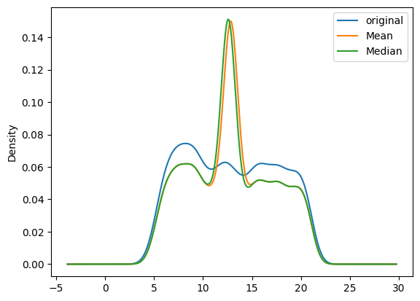
Handling missing values
Mean and median method
The mean and median value
curve is not alike original
value curve.
Fig: Mean median plot

Slide 6
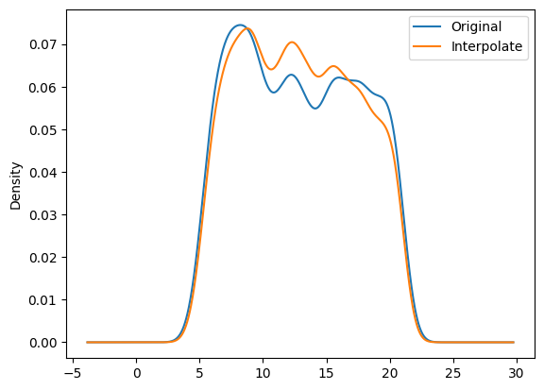
Handling missing values:
Linear interpolation
Method description:
Linear interpolation is a method for
estimating missing values by
connecting two
known data points with a straight line
and using this line to predict intermediate
values. It assumes a linear change between points,
providing a simple and effective
means to ensure data continuity and completeness.
Fig: Linear interpolation graph
The linear interpolation method
fill the null values which looks like
original value curve.

Slide 7
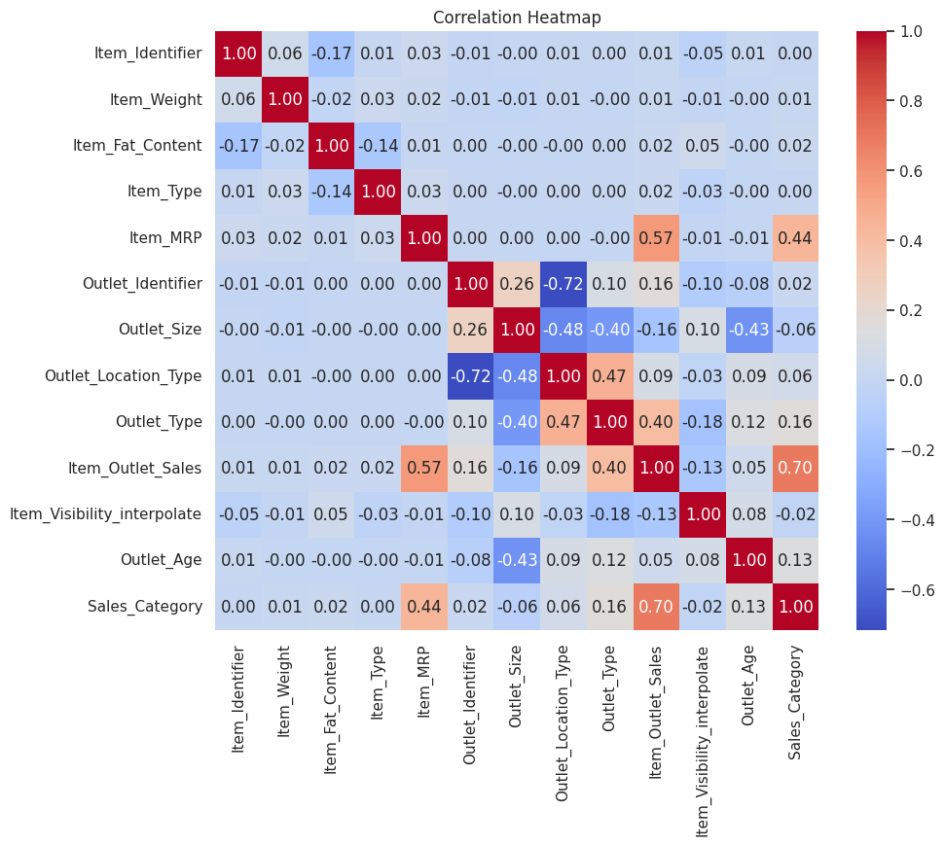
Correlation Heatmap

Slide 8
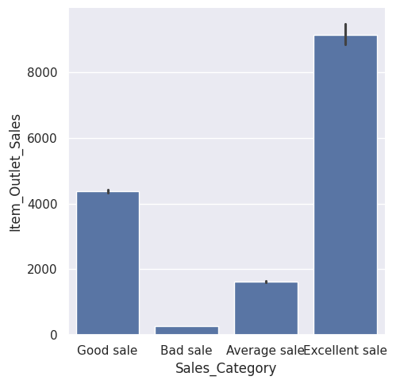
Most correlated features
Sales categories according to the
amount of sales in outlets
in USD.
Fig: Sales_Category vs Item_outlet_sales graph

Slide 9
Feature selection
Before Selecting features:
{'log_reg__C': 100, 'log_reg__max_iter': 10000, 'log_reg__penalty': 'l1', 'log_reg__solver': 'saga'}
Best Score: 0.9956002048267687 Cross-validation scores: [0.99765396 0.99472141 0.99882698 0.99589202 0.99706573]
Mean cross-validation score: 0.9968320185039857
Selected features: [False False False False False False False False True False False False]
Feature ranking: [ 4 7 11 8 9 5 2 3 1 10 12 6]
After Selecting feature:
Best Parameters: {'log_reg__C': 100, 'log_reg__max_iter': 2500, 'log_reg__penalty': 'l2', 'log_reg__solver': 'saga'}
Best Score: 0.9980936264880601
Cross-validation scores: [0.99824047 0.99941349 0.99941349 0.99765258 0.99941315]
Mean cross-validation score: 0.9988266352759766
Selected features: [False True False]
Feature ranking: [2 1 3]
We have used Top-N feature selection method where top 3 features were selected.

Slide 10
Accuracy:
Used model : The model was trained using logistic regression and the following accuracy is found
For training data:
r_squared value: 99.79 %
mean squared error: 0.0016133763567028453
For testing data:
r_squared value: 99.66 %
mean squared error: 0.0017595307917888563
Test Accuracy: 0.9994134897360704

Slide 11
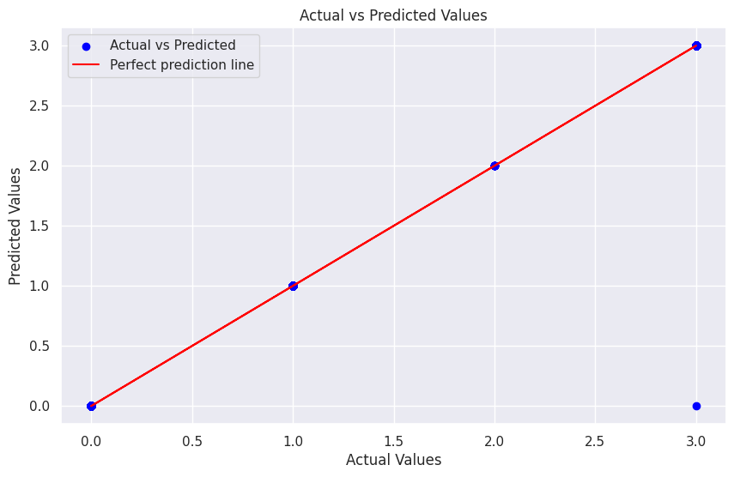
Accuracy
Fig: Actual vs Predicted value graph

Slide 12
Challenges Faced
We faced some technical difficulties like:
Run time error
Long run time
Retrain a model again and again .

Slide 13
Improvement
Data quality assurance
Preprocess the data more elaborately
Better model prediction
Use appropriate performance metrics

Slide 14
Thank You

